Slide 1
Data science ca2
Michael Flynn

Slide 2
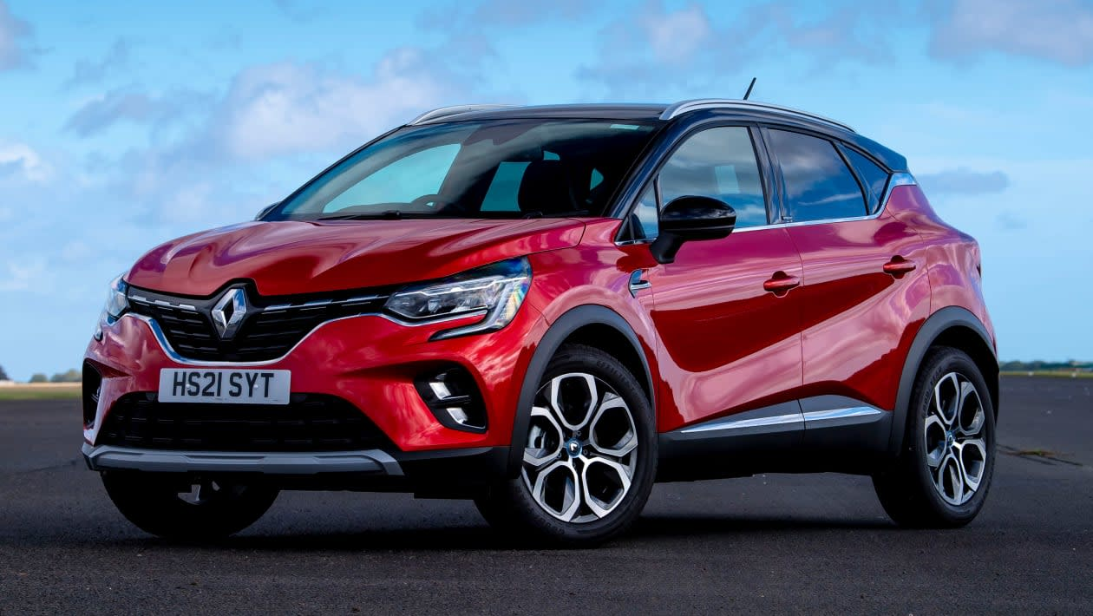
INTRODUCTION
THE PROBLEM: Trying to Predict the factors that effect KM travelled in a car (more specially Renaults)
Who Can this Benefit?? – People Who Are buying a new car as they can see how the distance could affect the Price, this can go for sellers as well as their potential customers may be reluctant to buy a high mileage car.
The main industry this applies to is the motor industry which includes private sellers, dealerships and the buyers
My Reason for focusing on Renault in particular is that its model of car I’ve been driving for 5 years, and I want to purchase a new one in the new year
SOME IMPORTANT QUESTIONS
Engine & Price – Question One: Do Cars with a Bigger Engine Cost more money than a Car with a smaller One?
KM & Years – Question Two: Do Older cars have a higher mileage then cars manufactured after them
Price and Location – Question 3: Are Cars from the "richer parts" of Ireland more expensive to purchase then cars from “poorer” counties https://twitter.com/r_o_farrell/status/1493912709800341507 - states that Dublin, Limerick, Kildare, Meath, Wicklow & Cork are richest
Year & Price – Question Four: Are cars that are newer more likely to be more or less expensive
Location & KM - Are cars from counties that have a higher urban population such as Dublin more or less likely to have cars with lower distance travelled

Slide 3
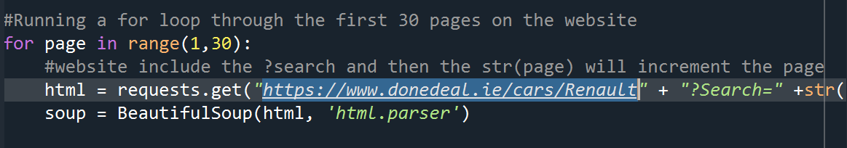
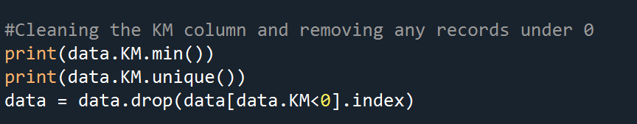
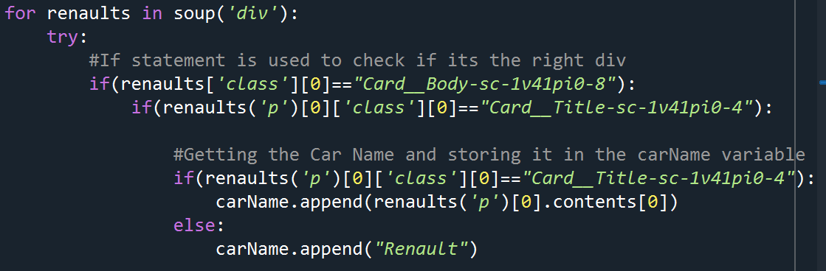
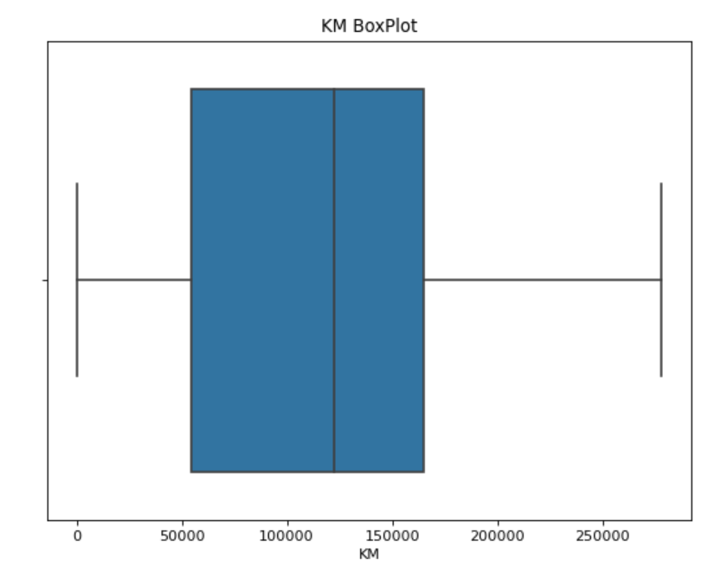
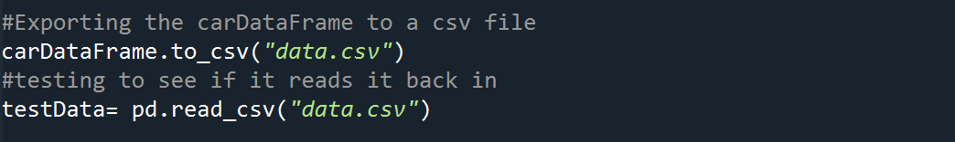
DATA MINING & CLEANING
WEBSITE USED: https://www.donedeal.ie/cars/Renault
HOW IT WAS DONE:
Firstly called the website using Beautiful Soup and ran it through a for loop that got the first 30 pages of the website
CLEANING THE DATA
HOW IT WAS DONE:
Firstly I removed all records that had -1 for KM, Year and Price
Once I got this I was then able to access the content on this website by IF statements to make sure I was in the correct
Then I checked to make sure there were no missing values and then checked for outliers in the data using box plots
Finally it was a matter of appending the data into variables and merging into a car list and then reading it as a data frame and exporting as a csv file

Slide 4
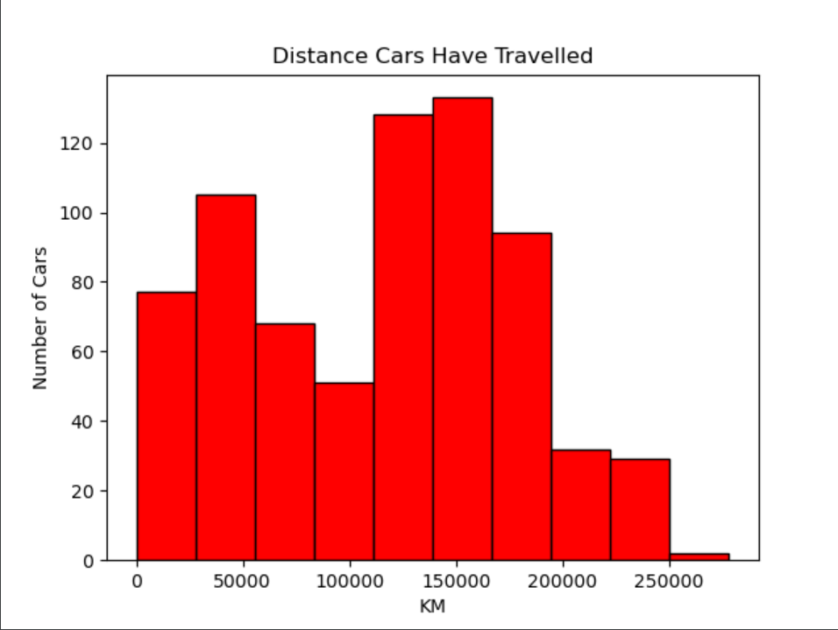
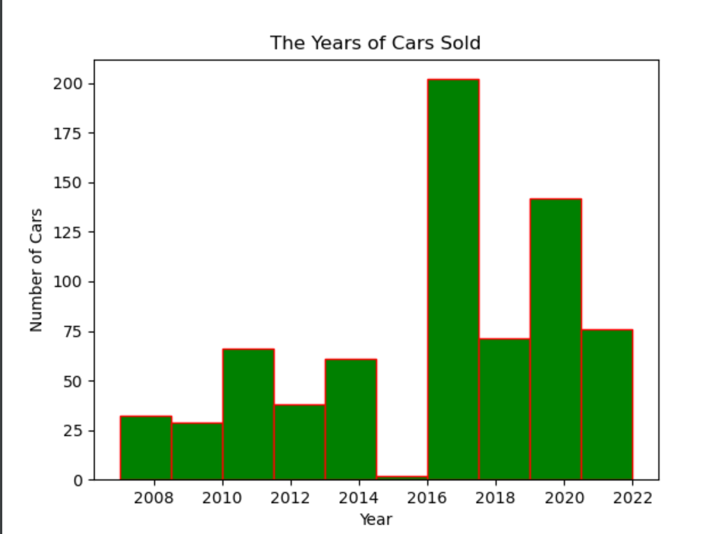
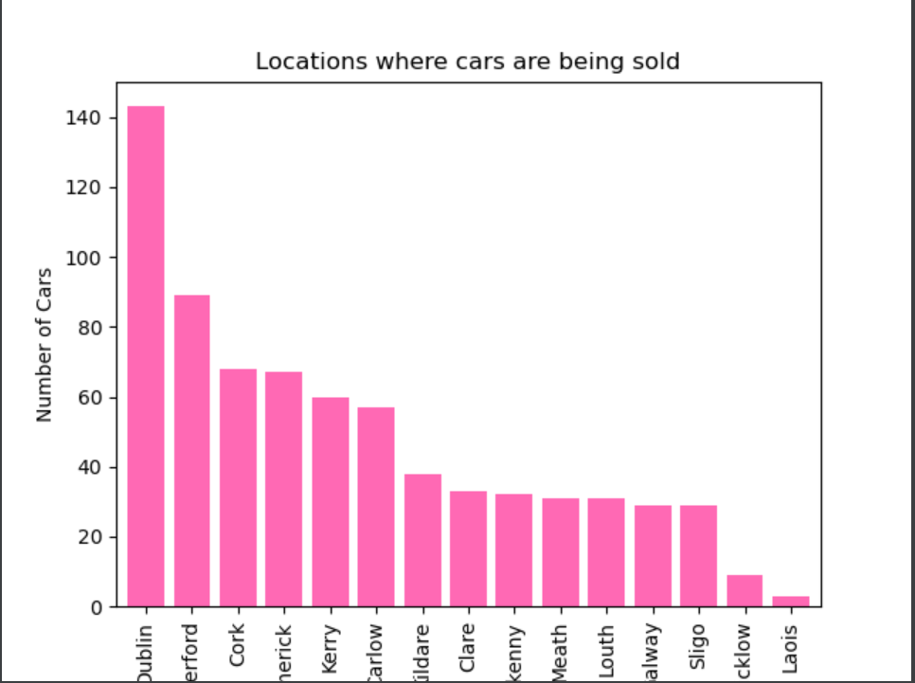
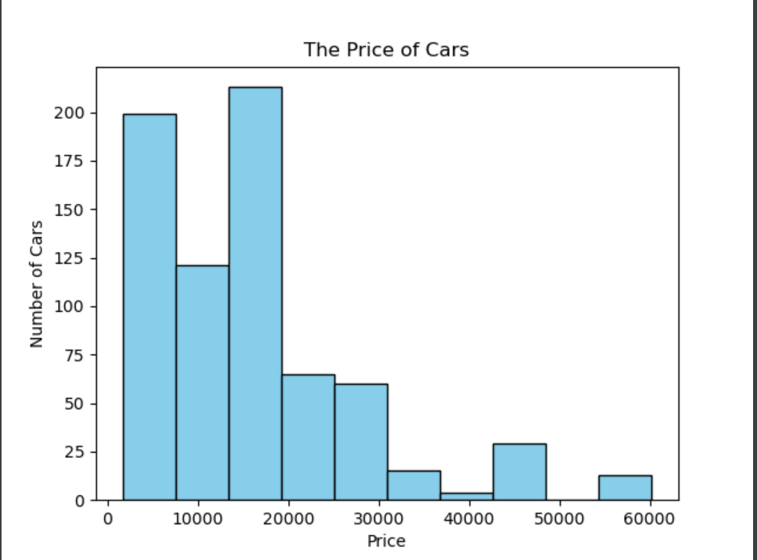
Exploratory data
Exploratory Data Analysis
In My Exploration & Analysis, I wanted to find the key information beneficial to my findings.
Univariate Findings
1, Engine Size – Pie chart that shows compares Petrol Vs Diesel – Shows over 80% of cars being sold are diesel
2, Car Year- Bar chart showing the number of cars being sold from a certain year– shows most cars are from 2017
3, KM – Bar chart showing the distance cars have travelled- shows that over 120 cars have travelled over 150000
4, Car Price - Bar chart showing the prices of car, shows most cars cost less then 2000 euro
5, Location- Bar chart showing where the most cars are being sold from - Dublin

Slide 5
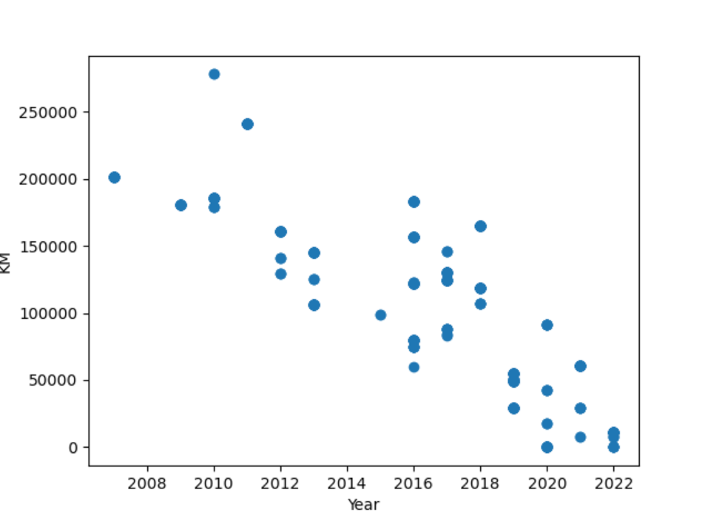
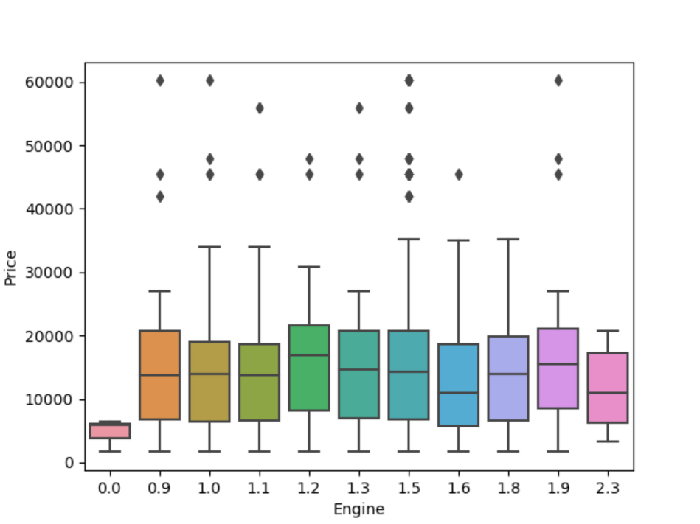
Exploratory Data Analysis
In My Exploration & Analysis, I wanted to find the key information beneficial to my findings.
Bivariate Findings
1, Engine & Price – Box showing how price and engine size compare
2, KM & YEAR – Scatter graph showing a negative correlation between KM and Year
3, Price & Location – shows if there is any connection between price and location

Slide 6
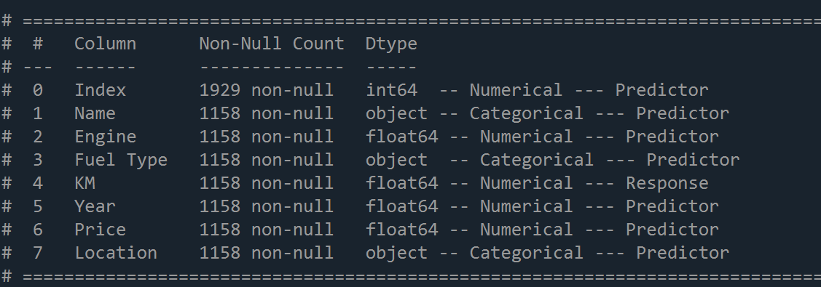
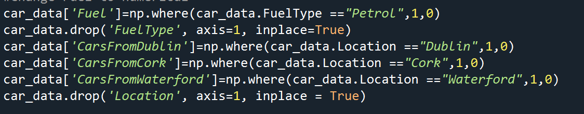
FEATURE ENGINEERING
STEP ONE – Identify the variables
STEP TWO – Drop Certain Variables, Removed the Index and Name from as they were not relevant
STEP THREE- Constructing new variables – Made new variables for Fuel Type that turns petrol and diesel to one and zero and split location up

Slide 7
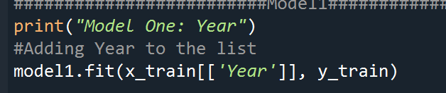
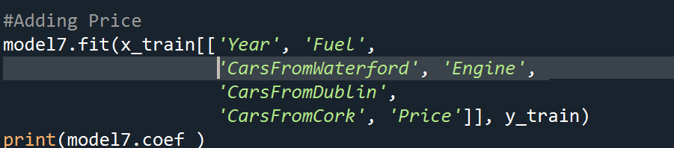
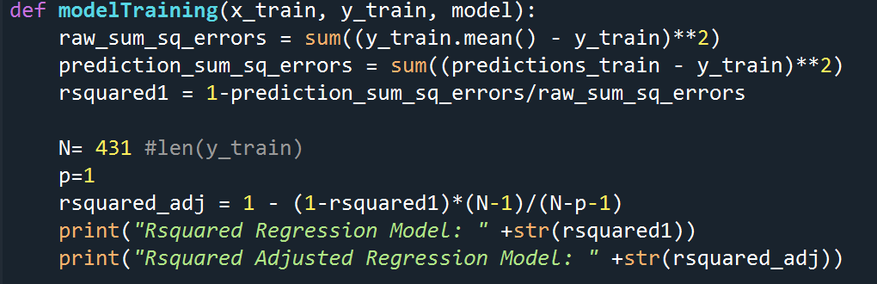
DETAILS OF MODELS
Linear Regression Model
Steps Taken:
STEP ONE – Split the x (predictor) and the y (response)​ variables and split the test and train model 67/33 (train/test)
STEP TWO – Based of the strongest correlation to KM, I began to fit my model
I had 7 Models so I had to fit the models with each variable from strongest to weakest
With each model I found the coefficient and the intercept. And finally I calculated the rsquare and rsquare adjusted
After fitting 7 models the best rsquare adjusted I had was 72%

Slide 8
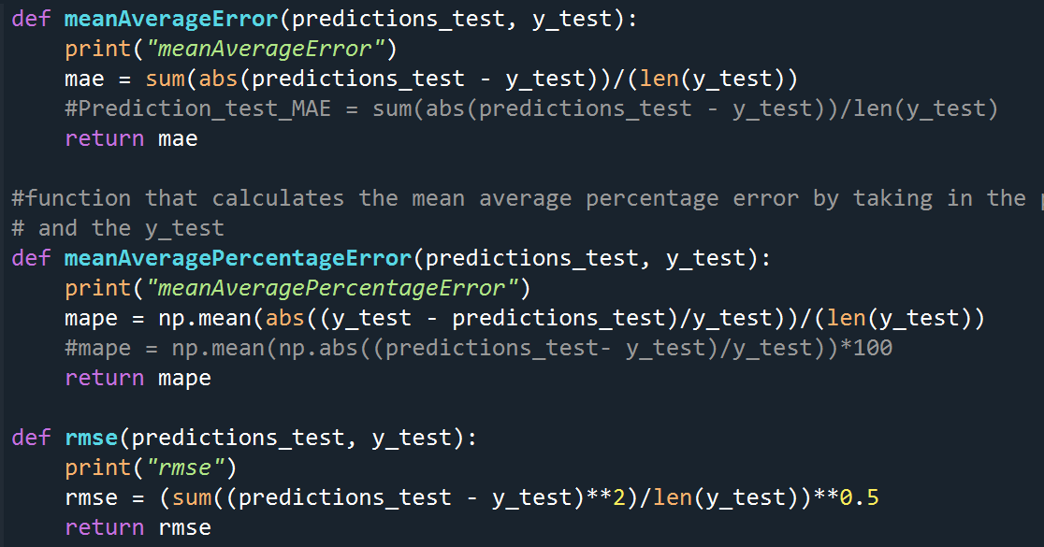
DETAILS OF MODELS
Model Evaluation Based on TEST set
Based off my previous training I used model 5 as this was one of the three joint highest at 72%
In this section I wanted to find the MAE(Mean Average Error), MAPE (Percentage Error) and finally the Root Mean Square Deviation,
This Area I did run into some issue, that I was unable to figure out why
For example the RMSE was extremely inaccurate and the MAPE was similar
I used the functions on the left to find these three

Slide 9
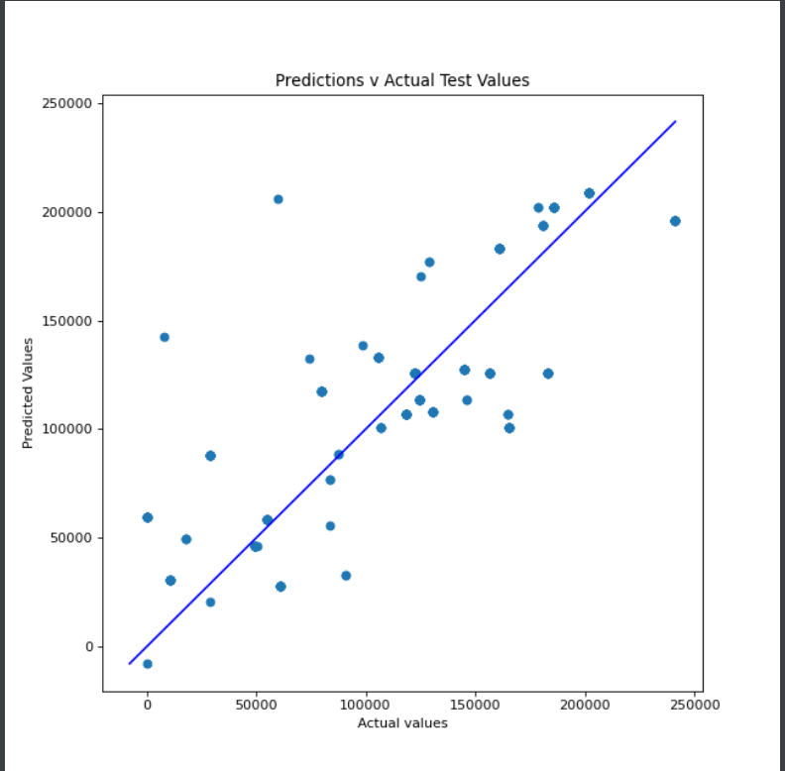
Communications of finding for step 6
Predictions Vs Actual Test
In this scatter graph I wanted to see how close my predictions form the linear model were to the actual tests, in an ideal world these results would be scatter close together in a straight line
You can see from this graph that my prediction model does get some of the values spot on, most are close to the line and there are a few outliers
Conclusion – I think my model is good not great but it could be used by companies or buyers to predict the distance travelled of a second hand car

Slide 10
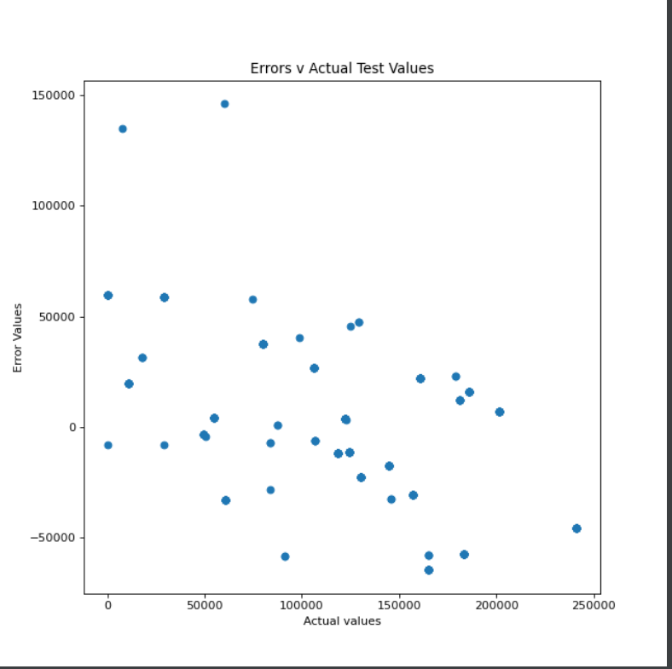
Communications of finding for step 6
Errors Vs Actual Test
In this scatter graph I wanted to see how the errors values compared to the actual vales
You can see from this graph many of the errors were ranging from 50000 to –50000 which may seem like a huge number but considering most cars could have travelled well over 300000km I think this is a decent graph
Conclusion – Not a huge fan of this graph as it could be seen as unreliable

Slide 11

SUMMARY
What I found Challenging – Web-scrapping ​and calculating the MAPE & RMSE
What I enjoyed – Learning about linear regression and feature engineering
What I would Change – My Response I would change to classification for fuel types
Link to the screencast -- https://youtu.be/MY3g8RQFXyU

